Slide 1
Python programming
unit 4.1 – pattern matching

Slide 2

New in python 3.10: pattern match
match (value):
Value is evaluated value/object, which will be used to match to case patterns.
case (pattern):
Can have multiple case
Each case has a pattern, each pattern is a way of matching to the value/object from match
From pattern to value, is like “constructing” of value/object.
From value to pattern, thus is somehow like “destructuring”.

Slide 3
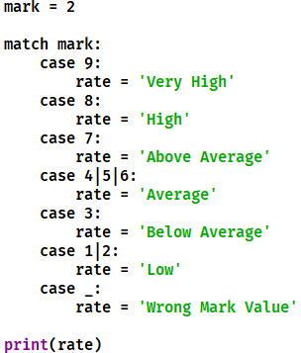
Simple example: literal pattern, wildcard pattern, OR pattern
Literal pattern are literal values of python:
number
string
None
True
False
_ as wildcard for any value. (wildcard pattern)
| as OR pattern, that is either one pattern to match

Slide 4
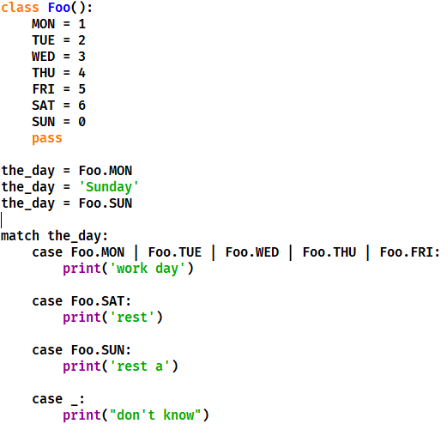
Constant value pattern
Dot name are constant value
In the case pattern, if have those constant value, they are evaluated to value and treated similar like literal pattern to match

Slide 5
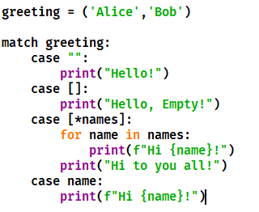
Capture pattern
The pattern in case has variable names, used to capture the value from the value/object at match statement.

Slide 6
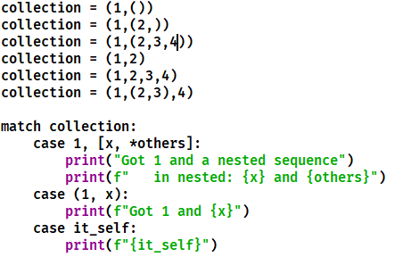
Sequence pattern
Same rule like unpacking.
Tuple or list from match, same rule to match to the case patterns.
[*_] matches a sequence of any length.
(_, _, *_), matches any sequence of length two or more.
["a", *_, "z"] matches any sequence of length two or more that starts with "a" and ends with "z".
Try the program with different value for collection and see the result.

Slide 7
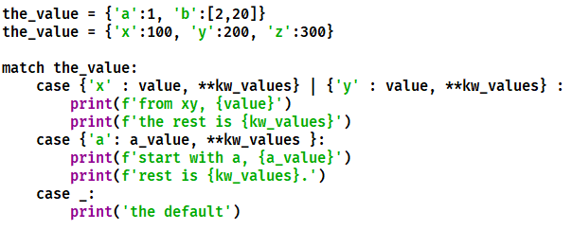
Mapping pattern
Pattern of key:value pairs.
Key is literal or constant pattern. Value can be any pattern.
Can use ** capture pattern, to capture as dict to a give variable name

Slide 8
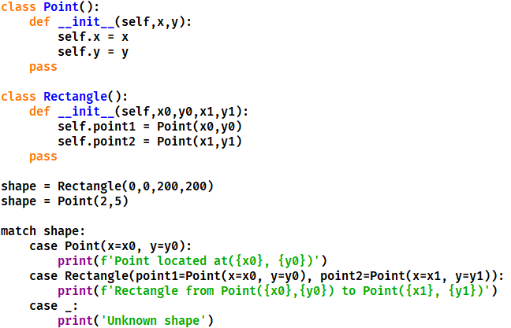
Class pattern
The case pattern specify attributes of class, similar like constructor of class.
The object/value from match statement, must be an instance of the class from case pattern. It is tested using isinstance()
For most of normal class must use keyword pattern for attributes
Only for tuple/dataclass, can use positional attribute pattern

Slide 9
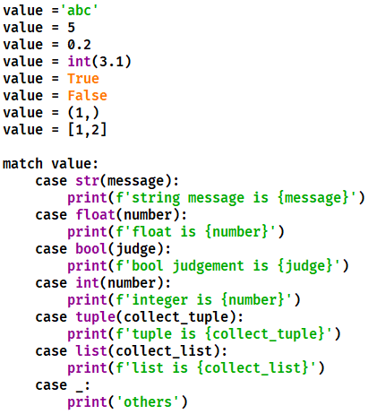
Match to build in class
Can use specific pattern to match to build-in class types
Bool will match to integer type, if integer case is put in front of bool. But integer cannot match to bool. So if have bool and integer at same time, put bool in front of integer.

Slide 10
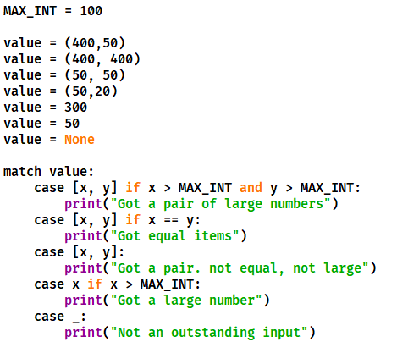
Guards in pattern
Use if to guard the pattern match. (limit the match under certain condition)
This guarded capture pattern, can cause many situation result in comparison error (when the value is not integer, not 2 items list /tuple)

